Slide 1
SA + SABP Introduction & Overview to Leaders
Training Leaders How to present and duplicate the SA and SABP
Same as SA Economics +SABP Introduction and Overview to leaders

Slide 2
Shopping Annuity Paradigm Shift You can not stop an idea whose time has come! + SA Bonus Pool Incentive Promotion The Future of Market America + Taiwan Unfranchise

Slide 3
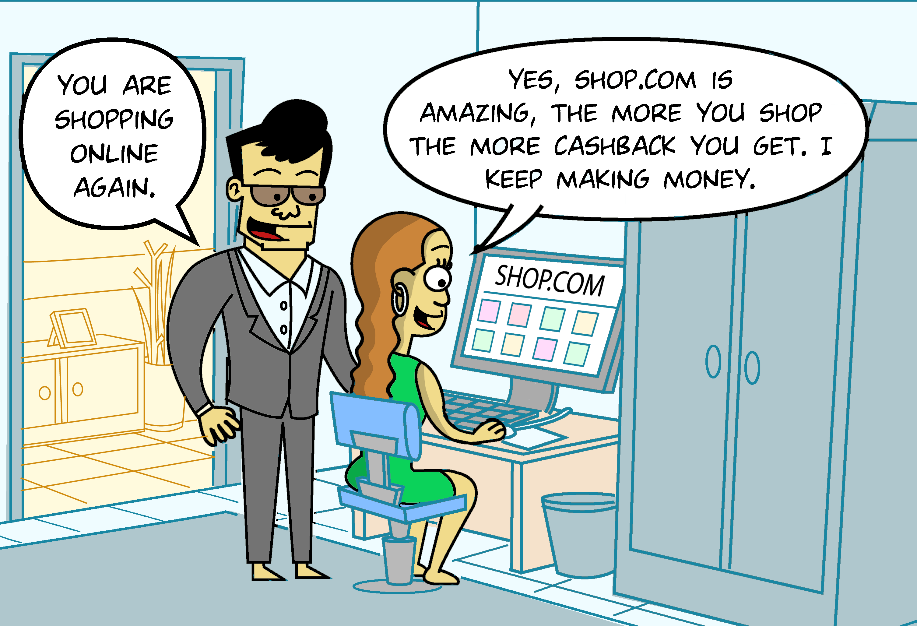

Slide 4
Why the Shopping Annuity can change the way people shop and cause a Global Economic Paradigm Shift

Slide 5
WHY
didn’t anyone do this before?

Slide 6
The technology was not available, A comparison shopping site with 50 million brands plus Market America’s products did not exist

Slide 7
Even with transfer buying it was too difficult to identify everything one was
buying/spending money on and to find a better deal online
was time consuming. Then to keep track of the list and
manage the orders and shipments, next to impossible.

Slide 8
Now it is all systemized, automated and becoming transparent. Now the Home Advisor, Shop Buddy, My list, and Auto ship functions do it all for you. It is automated and a no brainer!

Slide 9
Where did the profit go?

Slide 10
All Spending Age 0 to now
Our Contribution = Their Growth

Slide 11
Manufacturer’s
Point of View

Slide 12
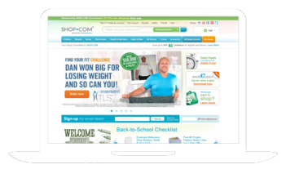
Cost: $5 Price $10
Now $100
Wholesaler
Retail Store
Ad
Sell $ $
Warehouse
Export $ $
Warehouse
Export $ $
Now $60
Now $40
Manufacturer
Warehouse
Internet Retailer
Now $80
Ad
Sell $ $
Direct Ship from Manufacture
Low Cost to seller $ $
Now $40
Now $60
Provide Product Info No Cost for them
1 to 1
Marketing
Direct Order
Search

Slide 13
6%
Consumer (Preferred Customer)
6%
BEFORE No Incentives
People
Power
People
Power
7%
Cash
Back
Cash
Back
18%
45%
US: 2～50% Cashback
Savings + discounts On everyday products you would buy anyway
Paid to shop + share on your purchases + referrals
55%
3500+ Partner Stores 50 million+ Products

Slide 14
UnFranchise Owner
Point of View

Slide 15
Mall without Walls
Search
Products
Daily
Spending
Cash
Back
Share
Profit
Exclusive Products
Search & Buy
BV IBV Cash Back
Consumer (Preferred Customer)
People
Power
Partner
Support
Provider (Partner Stores)

Slide 16
Steps/Evolution of MA
Shopping Annuity™

Slide 17
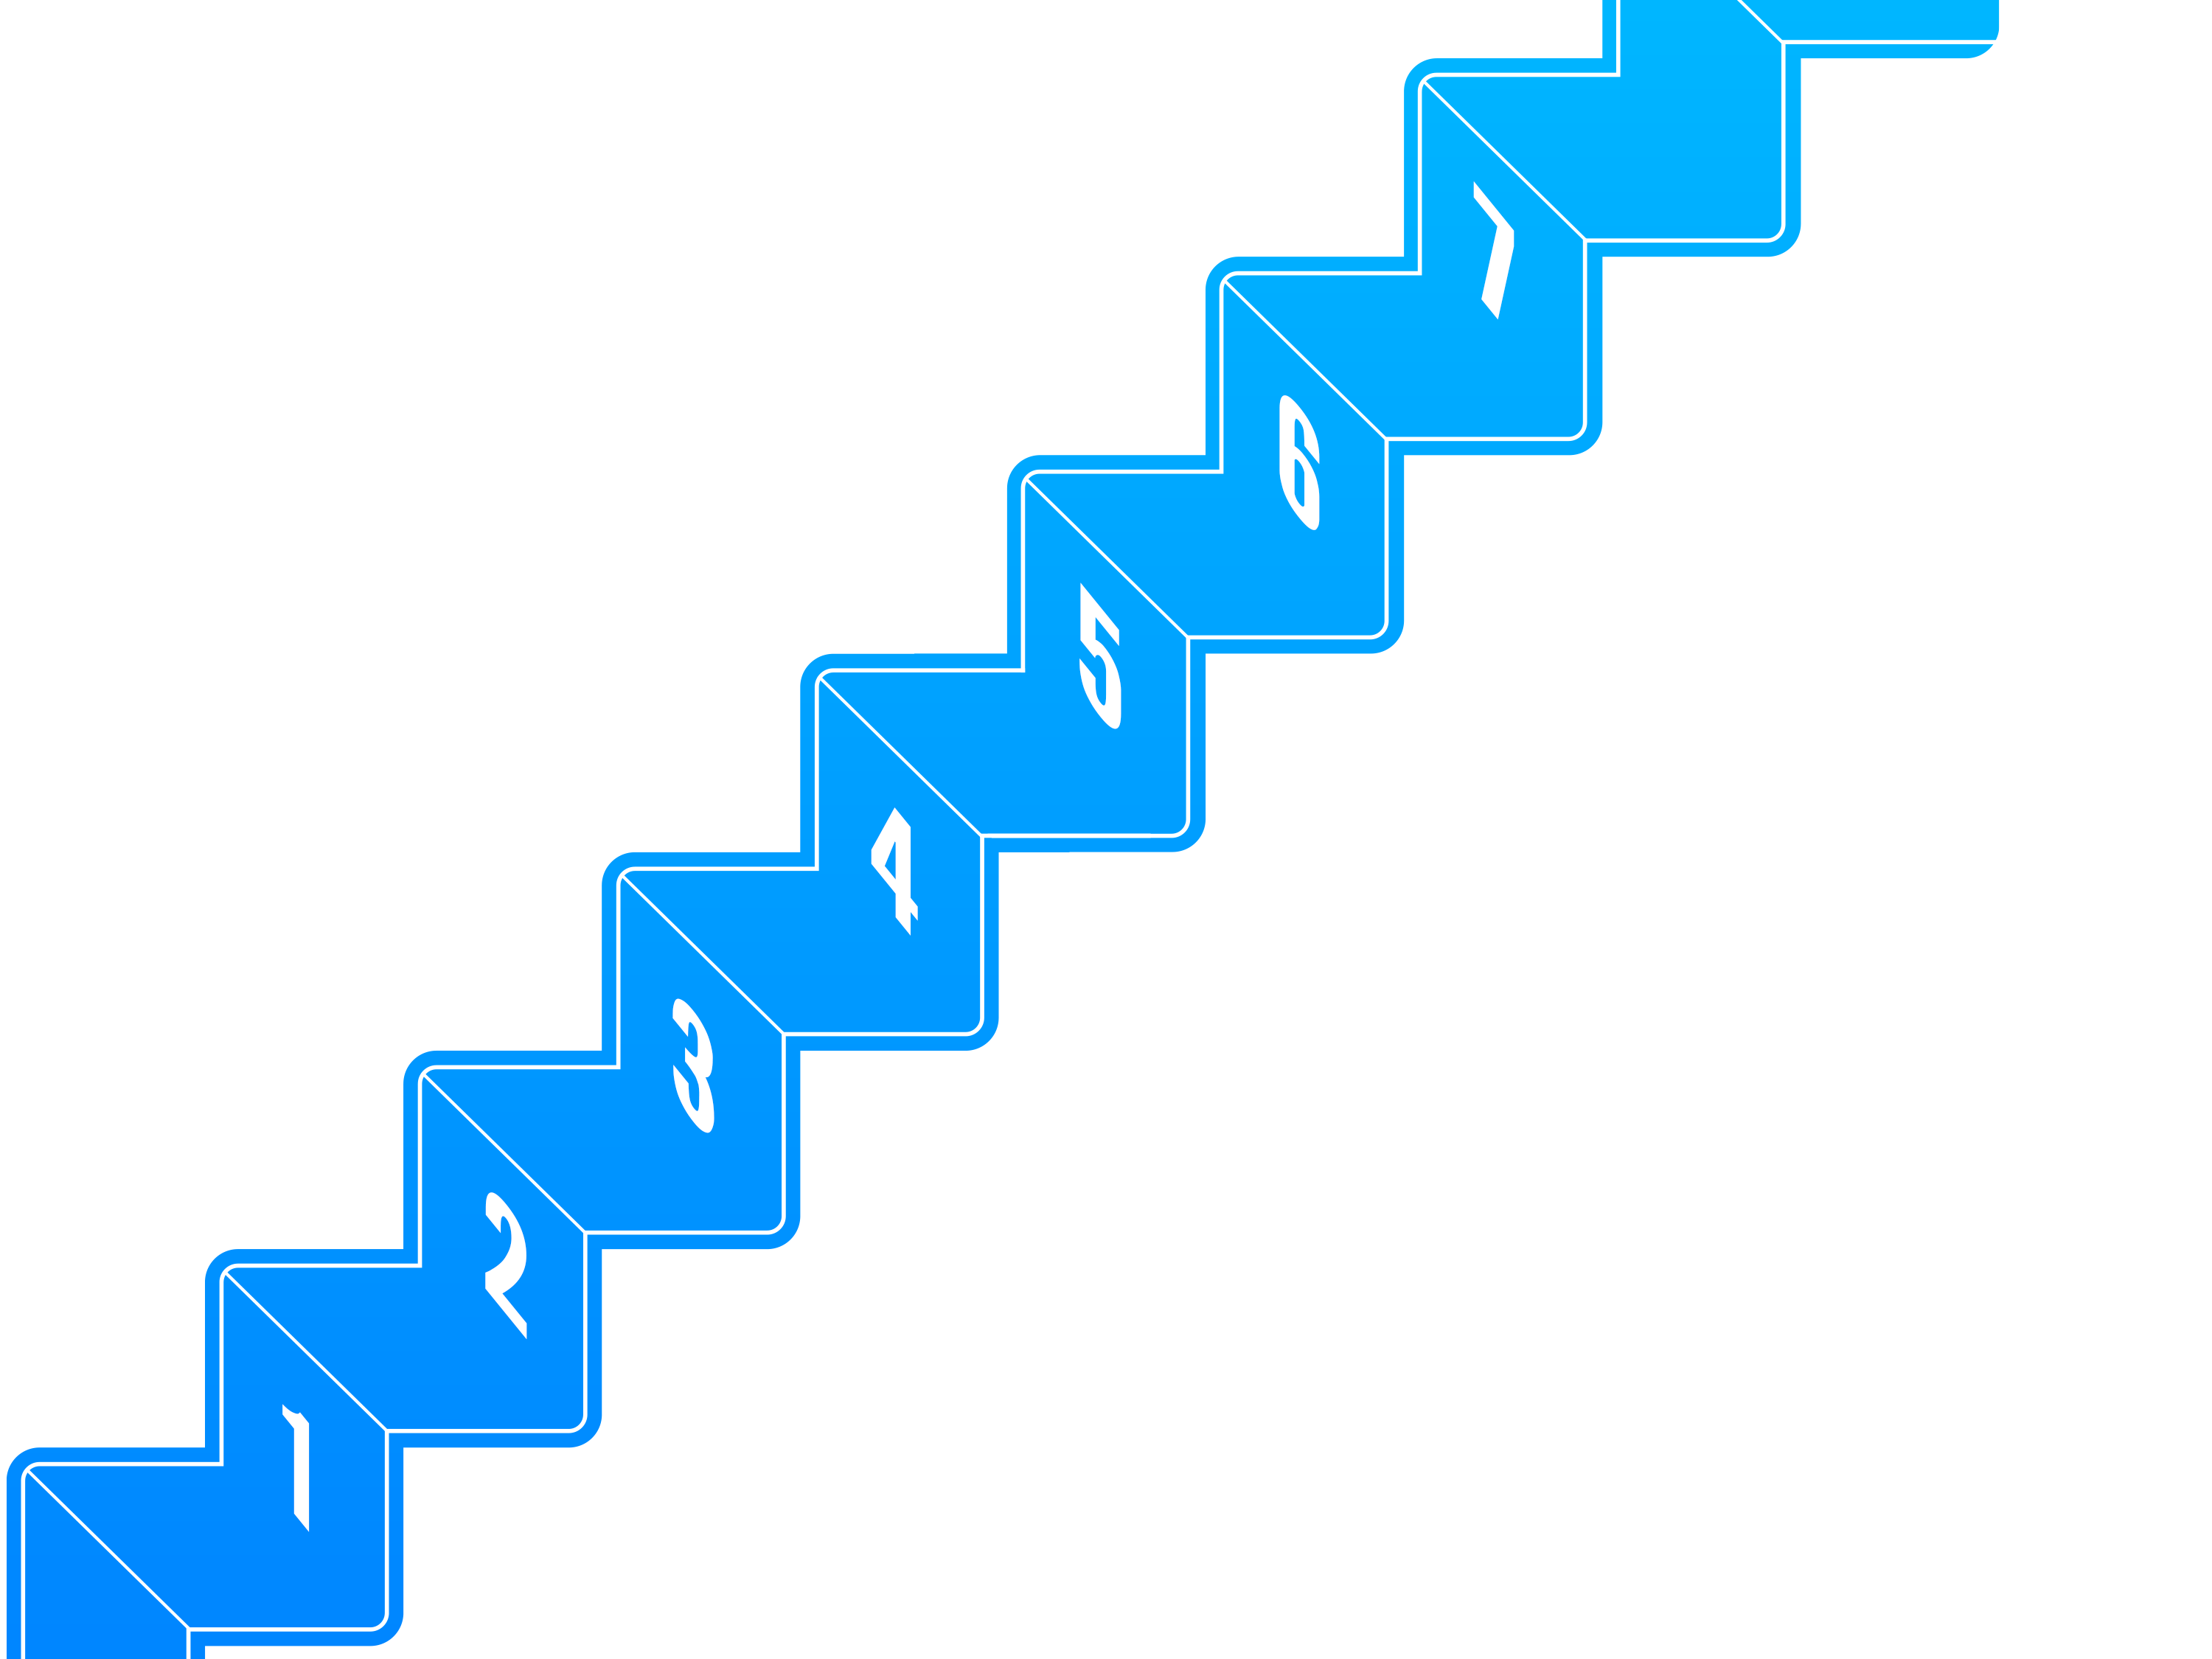
Simple steps starting with
The Assessment identifying
where your money is spent and redirecting it through Shop.com and unfranchise.com
Duplicate First 5 Steps
with Business Partners
Duplicate First 5 Steps with Customers
Install Shop Buddy on all PCs
Create Transfer Buying/Autoship
Create My List
Substitute ma Branded Products
Perform Household Assessment

Slide 18
YOU CAN NOT STOP AN IDEA WHOSE TIME HAS COME

Slide 19
It works better than any investment. Regardless of the performance of markets and the amount of discretionary you have or don’t have to invest; everyone shops and has to spend to live. Simply change your shopping habits. Buy the same products and brands for less money through Shop.com and change to Market America brands if you love them.

Slide 20
The choice is yours. Make the decision to convert your spending into earning.
Save $10,000 to $15,000 by changing your shopping habits from brick &
mortar to click and order.

Slide 21
What is the purpose and goal of the MA
Shopping Annuity™
Bonus Pool
The Shopping Annuity ™ Bonus Pool criteria that must be met to receive the bonus BV and IBV by each qualifying UFO result in a Model Shopping Annuity™ transferring all of one’s spending or shopping (80%) to MA at Unfranchise.com and Shop.com converting spending into earning and creating an ongoing regeneration of BV and IBV.
The Bonus Pool provides a large incentive for UFO’’s to do this immediately and a larger reward for UFO senior partners or leaders to make it happen.

Slide 22
Shopping Annuity™
Bonus Pool. What do I need to do? What do I get
for doing it?
To qualify and be eligible to receive a share of BV (around 200BV to 400BV and IBV around 50 to 100) a UFO must satisfy/complete the following five (5) criteria between October 1, 2014 – December 31, 2014 or in each quarter.
The BV + IBV Accumulation on the Qualifying Volume and the Pool Bonus BV +IBV on each down-line UFO is huge!
You must qualify for it yourself to get 100% credit on everyone on your team that does it and that is where the big $ is made—just like the MPCP. They work together!
Here are the 5 things you do to be a Shopping Annuity UFO Winner

Slide 23
What are the 5 things one must do to be a Shopping Annuity UFO winner?
1. Complete the Shopping Annuity Assessment. (Coming Soon!)
2. Complete the Online Shopping/Home Advisor during the respective bonus pool calendar quarter. (Previous completion will not count).
3. Download, install, login and use Shop Buddy on your computer. (Previous install and use will count).
4. Order at least 1,500 BV in Home Country Region products with the qualifying UFO being the Paying ID (9-digit Distributor ID#) for all orders between 10/1 – 12/31/2014.
5. Accumulate over $3,000 in Partner Store (partner, one cart direct) Home Region orders between 10/1 – 12/31/2014 with the following break down:
You can do it all yourself from shopping (this requirement is based on 80% of what the average person statistically spends) or… to give lee way and a head start:
First, at least $1,500* in purchases with the qualifying UFO’s Personal Preferred Customer ID (7-digit #) being the paying ID.
Second, the remaining balance of the $3,000 total for the respective quarter may be made up from purchases made by your registered Preferred Customers, or yourself.
Note: All returns will be deducted and reconciled against totals
.

Slide 24
Extra Bonuses to the Shopping Annuity Bonus Pool!
BONUS BV + IBV! When you qualify you get the additional Bonus Pool BV and IBV to place (Estimated :200 to 400BV and 50- 100IBV).
DUPLICATION BONUS BV +IBV: If you qualify for the bonus pool, you will also automatically earn an additional 50 BV and 25 IBV for each of your personally sponsored UFO that qualifies as well.
$600 LEADERSHIP BONUS IN IBV ELIGIBILITY: in addition, if you qualify for the bonus pool and have 10 UFOs in the left organization and 10 in the right organization of a BDC that qualify for the bonus pool; that BDC will be eligible to earn an additional $600 Bonus in the IBV compensation plan (same rules as the BV Bonus) for the next 12 weeks. This bonus is per BDC, so multiple BDCs are eligible for the IBV bonus. Note: the 12 week period will start the first week bonus BV and IBV are awarded.
BV + IBV ACCUMULATION and TIMING! All UFOs qualifying for the Shopping Annuity Bonus Pool will be eligible to accrue all awarded bonus BV and IBV generated and/or placed within their organization. Organize and mobilize your teams for massive action. The BV and IBV created will be enormous to those organizations that prepare and act! The fourth quarter 10/1-12/31 of 2014 and its holiday gift giving season is fast approaching.

Slide 25
Major Points And Light Bulb goes on!
(Be able to explain these!)
Why it takes a UFO business from operating at 10% -20% of potential in MPCP to 50%-80%
Why the BV and Shop.com IBV purchase amounts are realistic and possible to do.
The choice is yours. Make the decision to convert your spending into earning.
Save $10,000 to $15,000 by changing your shopping habits from brick &
mortar to click and order.
3. Why SA is possible with MA companies & Unfranchise
4. This is for UFO’S with Unfranchise DNA who are passionate and want to maximize their results by being Shopping Annuity Winners + Stars. Professionals.
5. Powerful affect of Duplication + 100% Accumulation. Must qualify. No Dilution. More UFO’s do it = More BV/IBV in Pool. No penalty to those who do it if brackets are not reached company wide.

Slide 26
Major Points And Light Bulb goes on!
(Be able to explain these!)
The choice is yours. Make the decision to convert your spending into earning.
Save $10,000 to $15,000 by changing your shopping habits from brick &
mortar to click and order.
5. Features to help you win!:
A)Protected both in overage + missing quota. Cannot lose.
B) Down line placement. Capture all Volume for MPC in TB centers downline.
C) Set up ordering on multiple list and pulls to match cash flow.
D) Quarterly allows periods allows monthly matching of usage.
6. Retailing and customer explosion due to: “What’s That” Phenomenon = more new sales volume from existing and new customers.
7. The Assessment is like showing plan UBP and signing up. Proves everything . Then do the the 5 steps with them in next month. They get in and then you do the 5 steps of MPCP over next month. Same with SA: They do Assessment, sign up and do SA 5 steps (Home Advisor + MY list + Orders)over next month.

Slide 27
What is meant by UFO’s operate at 10% -20% of potential & capacity of MPCP + UF System?
How does the SA increase UFO’s operating at 10% Potential up to 80% Potential?
The program has tremendous economic power and incentive behind it using what the field already believes in and understands – the MPCP.
Most UFO’s are operating the MPCP at 10% to 20%
(ie. < 8% of UFOs (USA) order SNAP Laundry, < 6% of UFOs (USA) order SNAP Dishwashing Liquid (see attached)) of the capacity and potential if the MPCP and should be operating at 50% to 80% of its potential.
That must be understood and embraced. It requires a behavior change in how they shop and buy, but the $ is already being spent.
Never before has there been a company or opportunity like MA that can do a shopping annuity
One product companies can not do this. We have 80% of everything people need or buy in consumable products in the MALL WITHOUT WALLS with Market America Brands that you get at wholesale and they replace multiple products, have added value, and are better. There is NO excuse not to buy them instead of things like Tide or Channel or Weight Watchers.
Everything else you or anyone buys or likes can be bought for less money on Shop.cpm
We have a tracking system that tracks and accumulates all that spending into a Shopping annuity putting the money spent by you and your team to work for you to earn checks!
It is about a philosophy and belief system and not about spending more. It is about saving money by changing the way they shop, Duplicating it has tremendous financial rewards.

Slide 28
Why does the Shopping Annuity increase UFO efficiency to 50%-80% of POTENTIAL OF MPCP?
The program has tremendous economic power and incentive behind it using what the field already believes in and understands – the MPCP (continued). This is not new to them and it maximizes earnings and results on something they already do.
MAXIMIZES VOLUME of you and your team simply redirecting the same spending through Shop.com and MA! 4 times the volume of the same team.
Retailing and PC sales double when UFO’s use all the MA products because of the “What’s That phenomenon”! Do you know this? We have PROOF!
Takes ¼ of the people or UFO’s to start earning weekly checks. New people earn much faster!
Takes ¼ the people or UFO’s to max out BDC’s at $2100 to $3600 per week!
Increases the number of people earning under a completed center thereby securing the income by other people earning
A game changer on IBV – Increases IBV on average by 8 times in an organization. Nationals and above begin earning weekly and more UFO’s start hitting checks now. IBV becomes more like BV.

Slide 29
SHOPPING ANNUITY FUNDING PLAN = MPCP
P
P
P
P
P
P
P
P
P
P
P
P
P
P
P
P
P
P
P
P
P
P
JACK
400 BV
P
P
P
P
P
P
P
P
P
P
$600
P
P
P
P
P
P
P
P
P
P
$600
$600
P
P
P
P
P
P
P
P
P
P
$600
165 IBV
165 IBV
400 BV
165 IBV
400 BV
400 BV
400 BV
165 IBV
2400
2400
618
2400
2400
618
2400
2400
618
2400
2400
618
618
1200
1200
618
1200
1200
618
1200
1200
618
1200
1200
P
P
P
P
P
P
P
P
P
P
P
P
P
P
P
P
P
P
P
P
P
P
P
P
P
P
P
P
P
P
P
P
P
P
P
P
P
P
P
P
P
P
P
P
P
P
P
P
P
P
P
P
P
P
P
P
P
P
P
P
400 BV
400 BV
400 BV
400 BV
400 BV
400 BV
400 BV
400 BV
288
1200
165 IBV
1200
288
288
1200
165 IBV
1200
288
288
1200
165 IBV
1200
288
288
1200
165 IBV
1200
288
288
1200
165 IBV
1200
288
288
1200
165 IBV
1200
288
288
1200
165 IBV
1200
288
288
1200
165 IBV
1200
288
P
P
P
P
P
P
P
P
P
P
P
P
P
P
P
P
P
P
P
P
P
P
P
P
P
P
P
P
P
P
P
P
P
P
P
P
P
P
P
P
P
P
P
P
P
P
P
P
P
P
P
P
P
P
P
P
P
P
P
P
P
P
P
P
P
P
P
P
P
P
P
P
P
P
P
P
P
P
P
P
P
P
P
P
P
P
P
P
P
P
P
P
P
P
P
P
P
P
P
P
P
P
P
P
P
P
P
P
P
P
P
P
P
P
P
P
P
P
P
P
400
400
400
400
400
400
400
400
400
400
400
400
400
400
400
400
165
165
165
165
165
165
165
165
165
165
165
165
165
165
165
165
P
P
P
P
P
P
P
P
P
P
P
P
P
P
P
P
P
P
P
P
P
P
P
P
P
P
P
P
P
P
P
P
P
P
P
P
P
P
P
P
P
P
P
P
P
P
P
P
P
P
P
P
P
P
P
P
P
P
P
P
P
P
P
P
P
P
P
P
P
P
P
P
P
P
P
P
P
P
P
P
3
3
3
3
3
3
3
3
3
3
3
3
3
3
3
3
3
3
3
3
3
3
3
3
3
3
3
3
3
3
3
3
Increase Operating from 10-20% to 50-80% of MPCP Potential

Slide 30
You Can Not Stop an Idea Whose Time has Come
Unfranchise DNA =
SHOPPING ANNUITY™
?
?
?
JUST TRY IT BY GOING THROUGH THE ASSESSMENT.
Proves you save $7500 or more by changing the way you shop and spend $. You win just by starting!
2. It justifies why the required BV and IBV amounts are in SABP,
3. It identify $ you are already spending monthly and yearly + where to find the products on Shop.com or Unfranchise.com.
4. It sets up a plan, projections, Schedule, and system for YOU.
It works better than any investment. Regardless of the performance of financial markets and the amount of discretionary income you have or don’t have to invest; everyone shops and has to spend to live. Simply change your shopping habits. Buy the same products and brands for less money through Shop.com and change to Market America brands if you love them.
The choice is yours. Make the decision to convert your spending into earning. Save $6,000 to $15,000 by changing your shopping habits from brick & mortar to click and order.

Slide 31
Shopping Annuity™ Bonus Pool Pioneer Program October 2014 = UFO Pioneer’s DNA Shopping Annuity Converting Spending into Earning
Pioneer's MA DNA Shopping Annuity Program: Up to 20 million in BV + 10 million in IBV/Qtr. for Pioneers to split. Rolls up in MPCP for all to benefit.
80 million BV + 40 Million IBV for Year
?
?
?
SA Bonus Pool Promotion.
Replaces ABP with Shopping Annuity Bonus Pool
2 million- 20 million BV
2 million minimum
Graduated scale up to:
10 million BV
50,000 UFO’s =
20 million BV
1 million to 5 million IBV
1 million minimum
Graduated scale
10 million IBV = 50,000 UFO’s
MA DNA SHOPPING ANNUITY
By completing 6 steps and changing where you order to MA + Shop.com
500 BV mo.
$1000 SHOP.COM PARNER ‘s
Around 100IBV/mo.
For !2 Months
This is YOUR Unfranchise DNA Test to see if you have it or not.
Up to 20 million in BV and Up to 10 million in IBV up for grabs to Pioneers who do it.
All the Bonus BV + Bonus IBV rolls up to Senior Partners so the more UFO’s on your team that do it the more you make awhile they hit pin levels and checks!

Slide 32
Starts October 1 – December 31- Repeats Quarterly SA Bonus Pool Pioneer Program– If you miss 1st qualifying round volume will accrue to the next quarter one time so why not get started!
SHOPPING ANNUITY LAUNCH
PIONEER PROMOTION
?
?
?
Do the 5 steps of the Shopping Annuity
Assessment
Home Advisor
Install Shop Buddy
Order – Transfer Buying + Auto Ship
Get 1 other Partner to do it
$500 BV /mo. Market America Brands Transfer Buying
$ 1000 Partners on Shop/mo.
Can use customers for ½ of $1000 IBV from Shop.com
Get other personally sponsored partner on Shopping Annuity for 50BV+ 25IBV on each.
Get 10 on each side = eligible for $600/wk. IBV - LB
REMEMBER THAT EVERYONE WHO QUALIFIES ON YOUR TEAM ACCUMULATES UPLINE TO YOUR CREDIT IN THE MPCP
THE MORE UFO’S YOU HAVE QUALIFIED- THE MORE BONUS BV AND IBV YOU GET

Slide 33
Steps of building a MA Shopping Annuity. Will you do it? How many partners can you get to do it with you? Just do it!
Duplicate First 5 Steps with Customers
Duplicate First 5 Steps with Business Partners
Install Shop Buddy on all PCs
Create Transfer Buying/ Autoship
Create My List
Substitute ma Branded Products
Perform Household Assessment

Slide 34
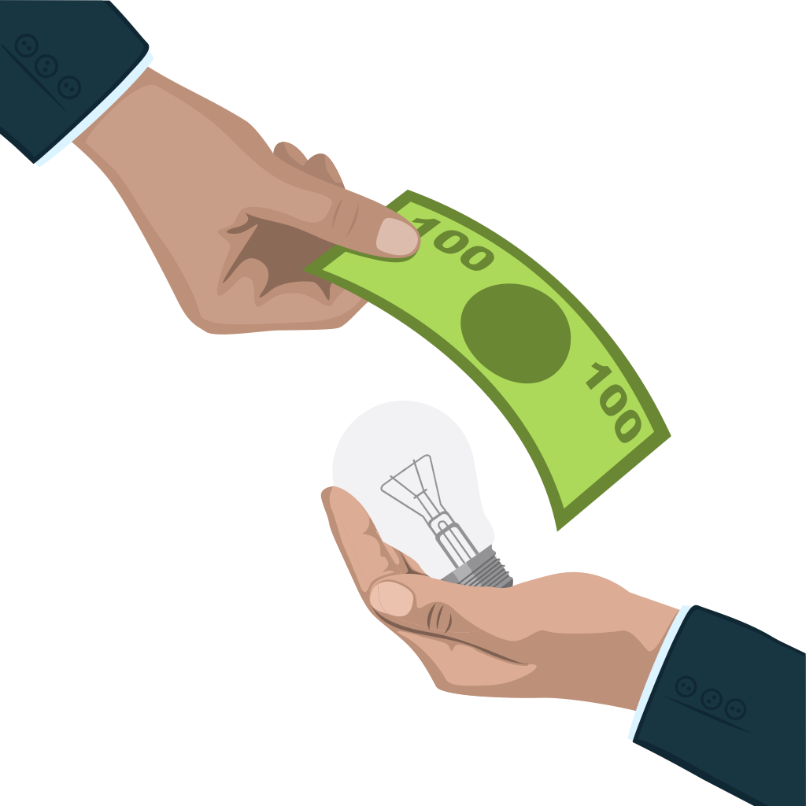
Simple Steps of MA ShoppingAnnuity Duplicate it with your team and get Bonus BV + IBV while quadrupling BV and IBV,
increasing your potential in MPCP from the avg of 10% to 50%-80% in months. It quadruples volume and takes ¼ the UF0’s to earn residual income!
50% to 80% Potential in MPCP
How many UFO Partners
Can you take through a SA
Assessment and sign up for
The Shopping Annuity ?
Step 6
Duplicate First 5 Steps with Customers
Step 7
Duplicate First 5 Steps with Business Partners
Step 5
Install Shop Buddy on all PCs
Step 4
Create Transfer Buying/Autoship
Step 3
Create My List
Step 2
Substitute ma Branded Products
Using Shopping Advisor
The Process and Discovery
Begins by Going through the
SA Assessment to determine
Where you spend $ and then
How much you will save and
Earn by Starting a Shopping
Step 1
Perform Shopping Annuity Assessment
Are You at 10% to 20% Potential of MPCP!

Slide 35
Shop.com – Market America Shopping Annuity opens October 2014! Get your MA DNA pioneer Share of SABP Bonus Pool 20,000,000 BV – 80,000,000,000BV
10,000,000IBV – 40,000,000 IBV

Slide 36
UnFranchise
DNA

